Slide 1
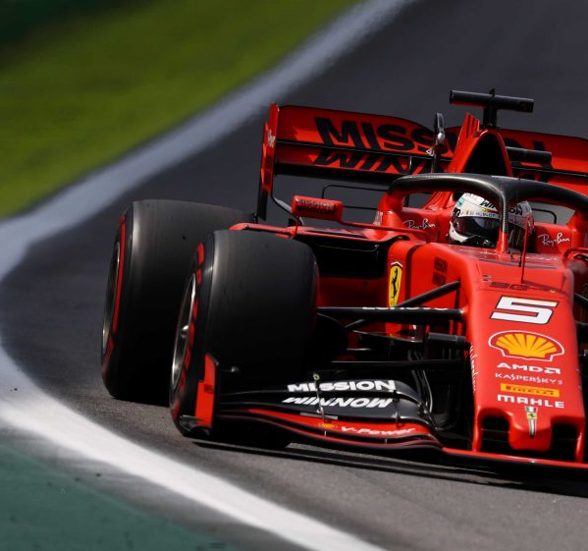
Formula 1 Race Strategy Optimization
Understanding the “Ferrari Disaster”
MSCA 32013 – Optimization and Simulation Methods for Analytics
Ben Ossyra, Peter Pezon, Yawen Zhang

Slide 2

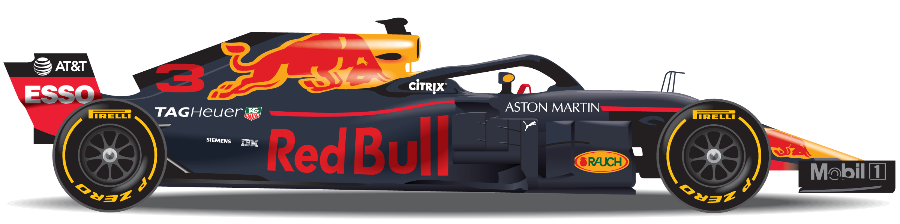
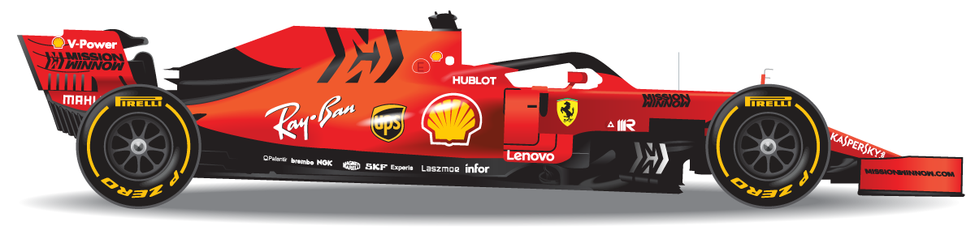
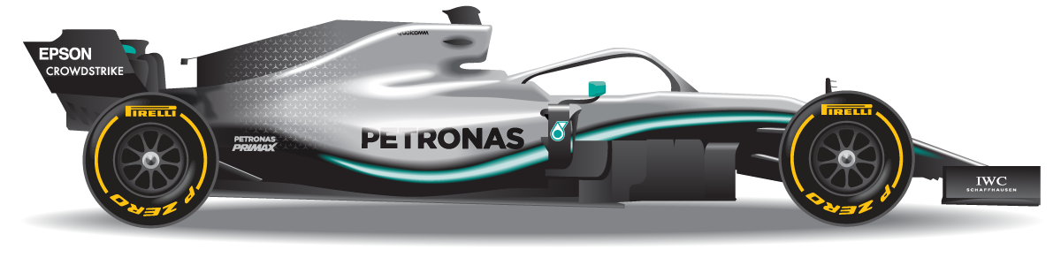
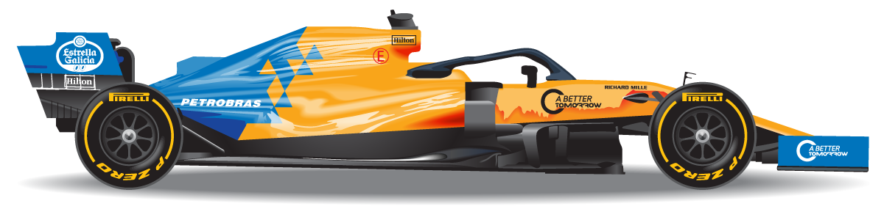
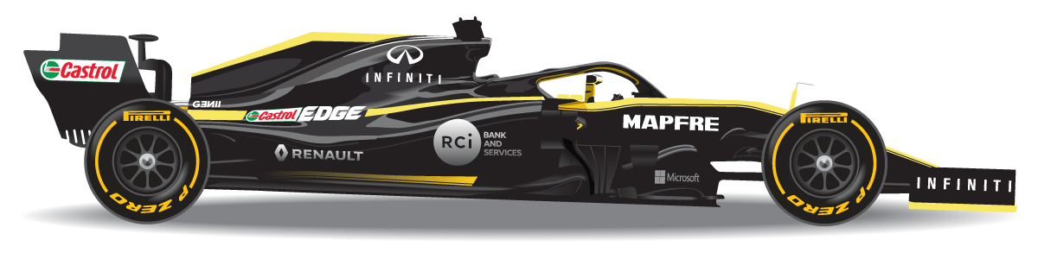
Introduction
3
Problem Statement
15
Approach
28
Results
33
Future Work
39

Slide 3

Introduction
Day One as the newest Race Strategy Engineer at Ferrari

Slide 4
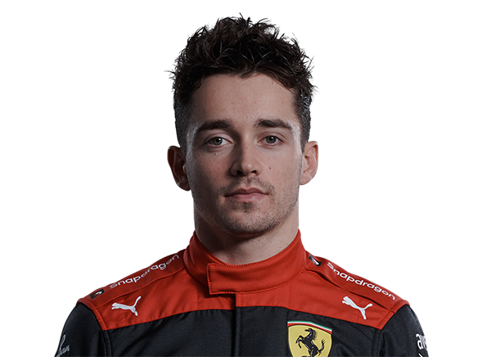
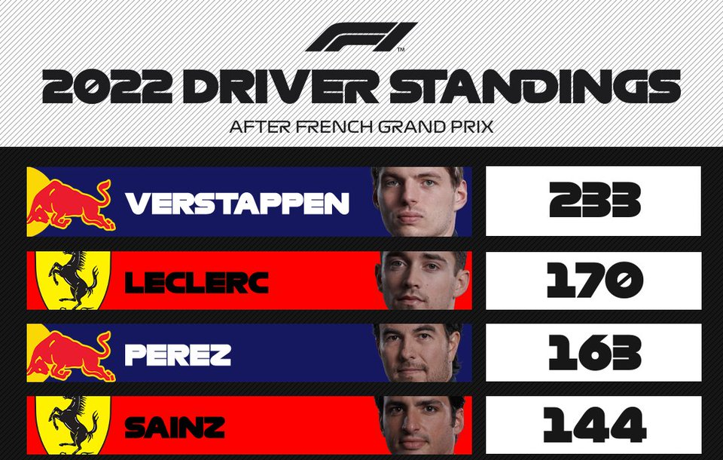
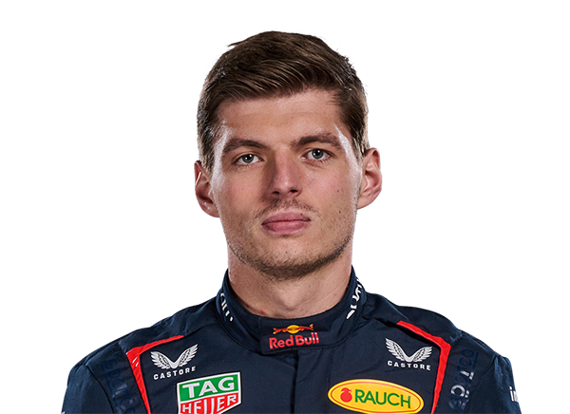
In 2022, the Ferrari was the fastest – however…
 | BHR | SAU | AU | EMI | MIA | ESP | MCO | AZE | CAN | GBR | AUT | FRA
VER | 2 | 4 | 2 | 1 | 3 | 2 | 4 | 3 | 1 | 2 | 1 | 2
LEC | 1 | 2 | 1 | 2 | 1 | 1 | 1 | 1 | 15 | 3 | 2 | 1
Qualifying Results
 | BHR | SAU | AU | EMI | MIA | ESP | MCO | AZE | CAN | GBR | AUT | FRA
VER | DNF | 1 | DNF | 1 | 1 | 1 | 3 | 1 | 1 | 7 | 2 | 1
LEC | 1 | 2 | 1 | 6 | 2 | DNF | 4 | DNF | 5 | 4 | 1 | DNF
Race Results
Charles Leclerc
Max Verstappen
Notes:
Entering the 13th race of the 2022 F1 season Charles Leclerc of Ferrari trailed Max Verstappen of Red Bull Racing by 63 points in the standings
A strong result from Leclerc was essential as he needed to start closing the gap on Verstappen
The weekend started well, Leclerc qualified third and Verstappen was a distant tenth
But by the end of the race Sunday, Verstappen stood atop the podium and Leclerc was sixth

Slide 5
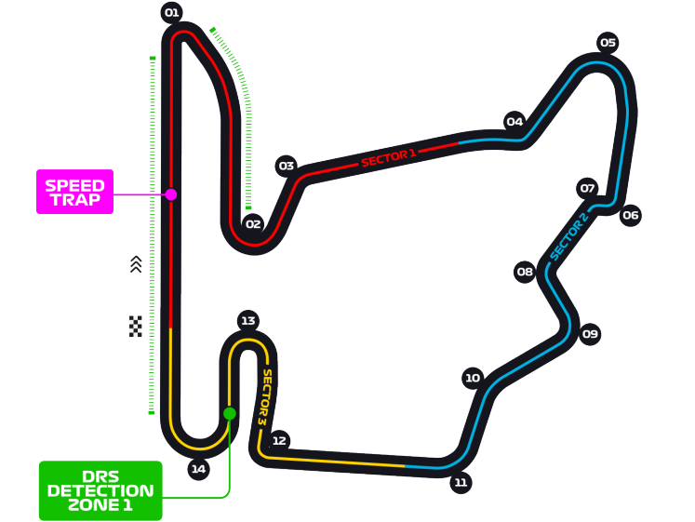
Hungarian Grand Prix 2022
Budapest, Hungary
First Grand Prix 1986
Number of Laps 70
Circuit Length 4.381 km (2.72 mi)
Race Distance 306.63 km (190.53 mi)
Lap Record 1:16.627 Lewis Hamilton (2020)

Slide 6
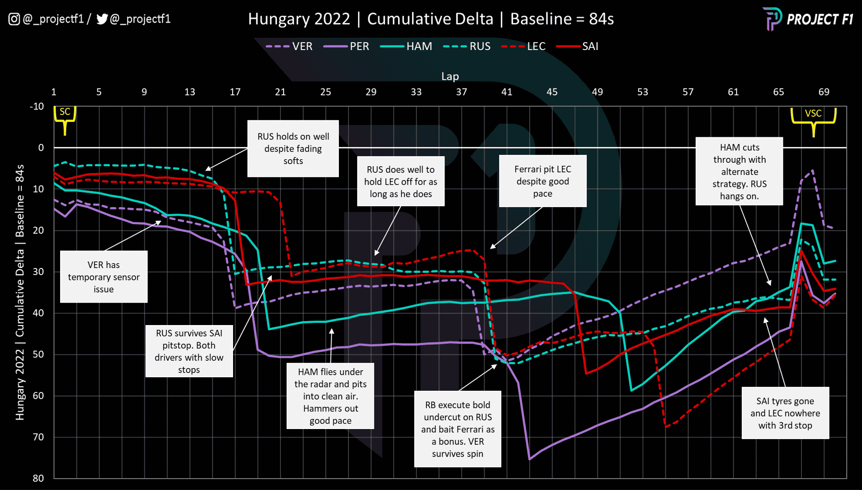
Race story: hard tire was a “turning point”
Notes:
https://www.motorsportmagazine.com/articles/single-seaters/f1/red-bull-and-mercedes-show-the-assertive-strategy-that-wins-titles-hungarian-gp-data-analysis/?v=79cba1185463

Slide 7
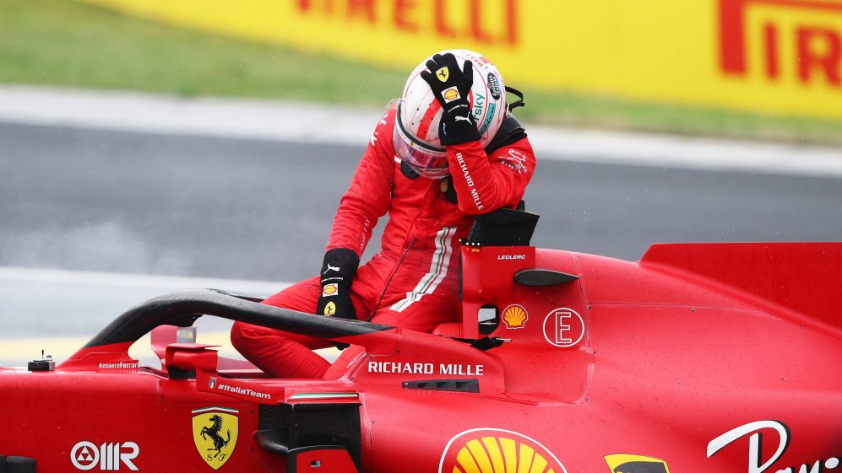
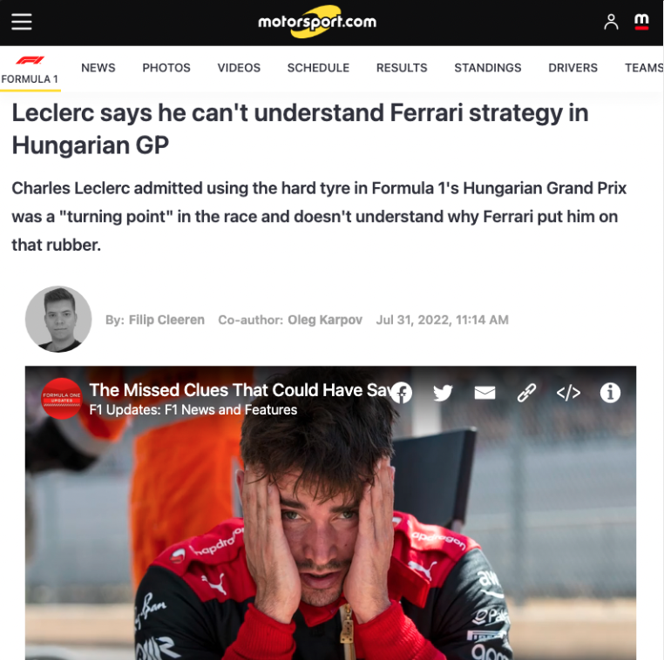
What happened to Ferrari?

Slide 8
By most accounts Ferrari were doomed by poor race strategy
Leclerc pitted 3 time during the race and was the only driver finishing in the top 15 to take 3 stops
Between lap 39 and lap 54, Ferrari opted for the hard tire compound. None of the finishers in the top 5 utilized the hard compound during the race
Sky sports analyst Jonny Herbert described the Ferrari strategy as "embarrassing", and Leclerc himself referred to it as a "disaster"

Slide 9
Formula 101
Premier motorsports racing league. 445 mil. global audience (Superbowl: 112 mil.)
Grands Prix (races) are held over 22 weekends over the calendar year.
10 constructors, 20 drivers compete for driver and constructor’s championships.
Points awarded to top 10 finishers of each race, plus fastest lap.
Multiple sessions are held on a race weekend.
Penalties are given in seconds or grid positions.
Place | 1st | 2nd | 3rd | 4th | 5th | 6th | 7th | 8th | 9th | 10th
Points | 25 | 18 | 15 | 12 | 10 | 8 | 6 | 4 | 2 | 1
Friday |  | Saturday |  | Sunday
Practice 1 | Practice 2 | Practice 3 | Qualifying | Race
Notes:
Disaster is a “relative term.” F1 is an affluent and precise sport. Teams spend hundreds of millions of dollars each season just so that a car can go around the track hundredth of a second faster, so mistakes are measured in seconds.

Slide 10
Drivers are given a set of tires each race weekend
Pirelli “nominates” a set of compounds for the weekend as hard, medium, and soft.
One set of the soft tires is set aside for Q3.
Two sets of medium and hard tires are kept for the race.
Cars must race on any 2 dry compounds.
Tire | Compound | Sets | Notes
Soft | C4 | 8 | Soft tires are the fastest but wear out quite quickly.
Medium | C3 | 3 | Medium tires falls somewhere in between.
Hard | C2 | 2 | Hard tires are slower but wear slowly.
Notes:
Takeaways:
Drivers must make at least one pit stop during each race
Drivers must use at least two of the three tire compounds
Pit stops can occur during any lap and there is no limit on the length of the number of laps between stops. The number of laps between stops is referred to as a stint

Slide 11
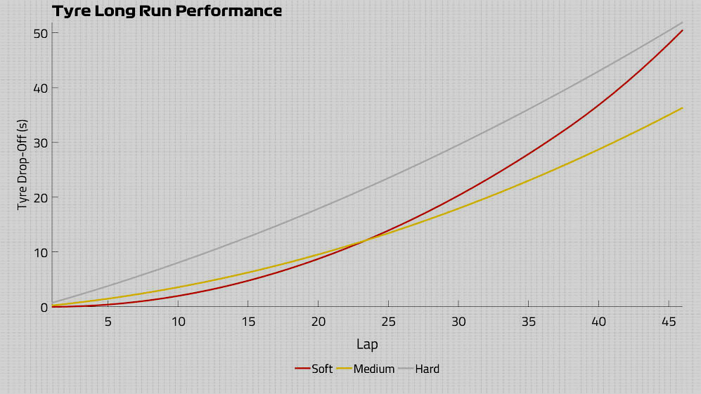
Long run performance of each compound…

Slide 12
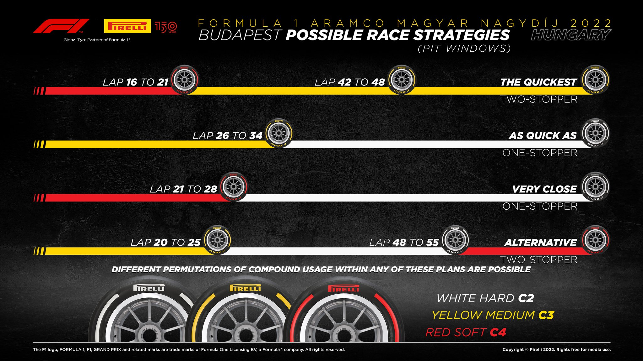
…creates opportunity for racing strategies…
Strategy 1
Strategy 2
Strategy 3
Strategy 4
Notes:
https://press.pirelli.com/2022-hungarian-grand-prix---sunday/

Slide 13
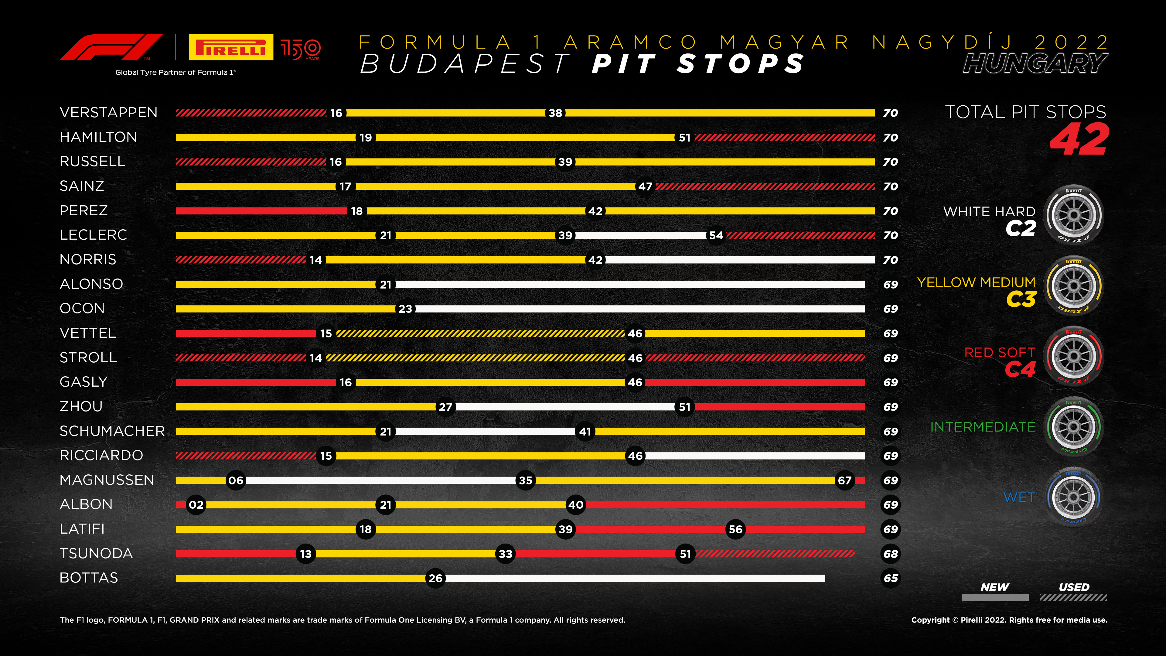
…which are executed with varying success
Strategy 1
Strategy 4
Strategy 2
Notes:
https://press.pirelli.com/2022-hungarian-grand-prix---sunday/
We see teams take different strategies that Pirelli recommended
And then we see Leclerc, who took none of these.
Let’s find out why and what it takes to be a strategy engineer

Slide 14

Hopefully, this is starting to look familiar!
We want to minimize race time (objective function)
Given a set of conditions (constraints)
Calculate stint lengths (variables) for each tire set that lead to the fastest race

Slide 15
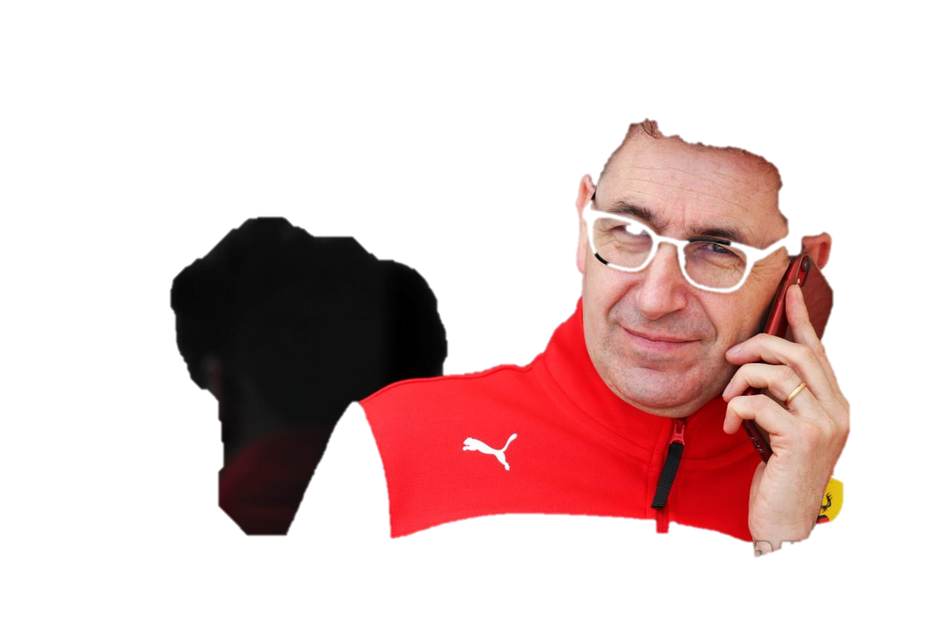
Problem Statement
Defining the optimal racing strategy

Slide 16

Tire inventory
S | S | S | S | S | S | S | S | M | M | M | H | H
3 | 3 | 5 | 7 | 10 | 11 | 12 | 14 | 0 | 0 | 18 | 0 | 2
Define a $n_{T}×2$ matrix T$.$ Each row describes a set of tires available for race week.
$$T=\left[\begin{matrix}a_{0} & c_{0} \\ ⋮ & ⋮ \\ a_{i} & c_{i}\end{matrix}\right]$$
Tires are described using the parameters $a_{i}$, the age of the tire, and $c_{i}$, the compound of tire $τ_{i}$.
$$τ_{i}=\left[a_{i} c_{i}\right]$$
$$a_{i}∈\left\{0,1,…,a_{M}\right\}⊂ℤ$$
$$c_{i}∈\{S,M,H\}$$
$a_{M}$ is the theoretical maximum life of tire compound $c_{i}.$
$$\left\{a_{M}≥a_{i}≥0|c_{i}\right\}⊂ℤ$$
Heuristic: Ignoring cross-hatched tire sets reduces the total number of simulations.

Slide 17

Racing strategy
Define tire set as an N$×2$ matrix ${\hat{T}}_{s}$. Splitting the race into a fixed number of stints N (pit stops = N − 1) with stint index i, tires $τ_{i}$and stint lengths $α_{i}$ as optimization variables for strategy s.
$${\hat{T}}_{s}=\left[\begin{matrix}τ_{1} \\ ⋮ \\ τ_{N}\end{matrix}\right], \overset{⃑}{a}=\left[\begin{matrix}α_{1} \\ ⋮ \\ α_{N}\end{matrix}\right]$$
Create strategies for all the possible combinations of tires from the remaining tire inventory.
Constraints:
$τ_{i}$ is sampled $N$ times from inventory without replacement.
At least two unique tire compounds in the set of ${\{c_{1},…,c}_{N}\}$.
Create $S_{i}$ strategies for each number of pit stops possible at a particular circuit between $\{P_{min},P_{max}\}$ , where $P_{min}$ is the minimum number of pit stops and $P_{max}$ is the maximum number of pit stops.
General rule: optimal number of pit stops in a dry F1 race without any unforeseen events is between 1-3
$${\{P}_{min}=1,P_{max}=3\}$$

Slide 18
Factors affecting race time
Circuit | Number of laps Time of fastest lap Time of pit stop Time penalty of fuel load per lap
Tire | Time penalty of tire degradation by lap Tire compound degradation laws Tire age

Slide 19
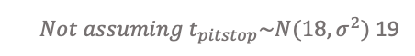

Minimizing race time
Race leader has the fastest race a.k.a. smallest race time.
Therefore, we want to minimize race time.
Race time is calculated by summing lap times and pit stops.
$$t_{racetime}=\sum_{i=1}^{N}{t_{pitstop}}+\sum_{l=1}^{L_{max}}{t_{lap}\left(l\right)}$$
Notes:
we want to minimize lap time, number of pit stops, and time loss from pit stop.

Slide 20

Lap time model
Time to complete a lap in seconds at a given lap:
$$t_{lap}\left(l\right)=t_{base}+t_{tire}+t_{fuel}+t_{pitlap}(l)$$
$t_{base}≡$ the fastest lap unladen with fuel $≡$ fastest qualifying lap
$t_{pitlap}≡$ the adjusted time from entering or leaving the pit lane, zero otherwise.
Time lost to fuel mass per lap:
$$t_{fuel}=t_{fuel}\left(l,l_{max }\right)=F(l_{max}−l)$$
Assume fuel mass is 110 kg at start of race, 0 kg at end of race, and lap time loss is 0.03 s/kg.
Notes:
Prepare lap times dataframe for all stints to compute LOWESS models for each tire compound.
1. First we remove the first lap and last lap because it is not representative as each car travel different distance from their grid position to complete the lap.
2. We consider each car is filled with 110 kilos of fuel at the start and finishes with 0 kilos at the end. For each kilo of fuel we assume a lap time loss of 0.03s.
3. To remove outliers such as safety car, virtual safety car, spins, driver errors we only consider laps with lap time within 107% of the fastest lap of the race.
4. To arrive at the lap times for each compound, we use LOWESS (Locally Weighted Scatterplot Smoothing) which gives us a nice model fit for scattered data points.
5. We use Tyre Life as x-axis instead of Lap Number to use all the data available across various stints. And for y-axis we use the Fuel corrected lap times.
There are still several factors that effect tyre performance but are difficult to account for such as driver errors, car performance, wind, traffic, DRS and so on, but still this is a decent approximation used by formula1 engineers because it works.
Source: https://tracinginsights.substack.com/p/ferrari-disaster-class-is-hard-compound
Beaume assumes 0.06 sec/kg.

Slide 21

Linear tire degradation model
Time loss $t_{tire}$ is determined by tire age $a$and two coefficients $k_{0} and k_{1}$, which are dependent on the tire compound $c$.
$$t_{tire}\left(a,c \right)=k_{0}\left(c\right)+k_{1}\left(c\right)∙a$$
$$k_{0}\sim pace, k_{1}\sim degradation$$
Generally, a softer tier is faster a$t first$: $$k_{0}\left(S\right)<k_{0}\left(H\right)$$
But displays a faster degradation:
$$k_{1}\left(S\right)>k_{1}(H)$$

Slide 22
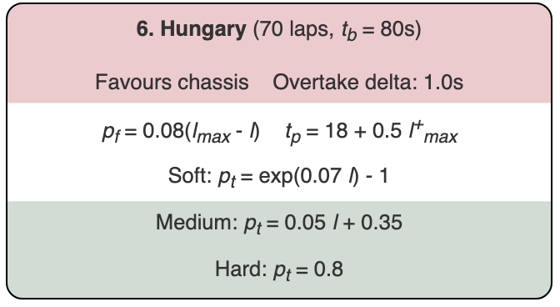

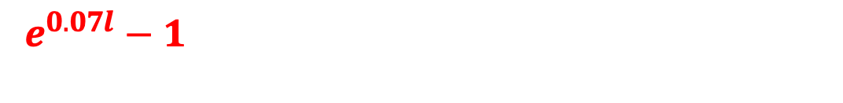
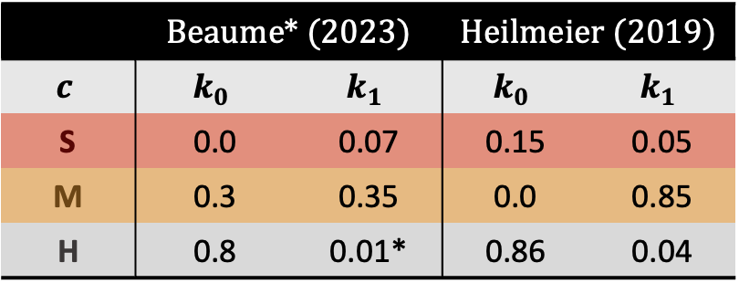

Coefficients $k_{0} \text{and} k_{1}$
Recall Taylor series expansion$:$
$$f(x)≈f\left(a\right)+\frac{f′\left(a\right)}{1!}\left(x−a\right)+\frac{f^{′′}\left(a\right)}{2!}{\left(x−a\right)}^{2}+…$$
Expand $e^{x}$
$e^{x}≈ e^{0}+\frac{e^{0}}{1!}\left(x−0\right)≈1+\frac{1}{1!}\left(x−0\right)≈ 1+x$
Evaluate at $x=0.07l$
$$e^{0.07l}≈1+0.07l$$
Substitute into tire model $t_{tire}$
$$t_{tire}\left(a,S\right)=\left(1+0.07l\right)−1$$
$$=0.07l$$
 | Beaume* (2023) |  | Heilmeier (2019)
$$c$$ | $$k_{0}$$ | $$k_{1}$$ | $$k_{0}$$ | $$k_{1}$$
S | 0.0 | 0.07 | 0.15 | 0.05
M | 0.3 | 0.35 | 0.0 | 0.85
H | 0.8 | 0.01* | 0.86 | 0.04
Beaume (2023)
$$e^{0.07l}−1 ⟺ t_{tire}\left(a,S\right)=k_{0}\left(S\right)+k_{1}\left(S\right)∙a$$

Slide 23

Order of tire compounds is irrelevant
Assumptions for modeling:
No unforeseen events
No other competitors
Tire degradation is linearly independent from fuel load.
Tire degradation keeps at similar level with reduced mass
Therefore, tire order does not matter.
$$t_{racetime}\left|SSM=t_{racetime}\right|SMS=t_{racetime}|MSS$$

Slide 24






Setup Mixed-Integer Quadratic Problem (MIQP)
$${min \atop {[α}_{1}…α_{N}]} \sum_{i=1}^{N}{\sum_{a=1}^{α_{i}}{t_{tire}(a,c_{i})}}$$
(1)
$$S\text{ubject} \text{to} \sum_{i=1}^{N}{α_{i}= l_{tot}}$$
$i$ = stint index
$N$ = number of stints
$c_{i}$ = compounds
$α_{i}$= stint length
$$α_{i} ∈ ℕ^{+}$$
$$∀1 ≤i ≤N$$
Recall the tire degradation model:
$${t_{tire}\left(a,c\right)= k}_{0}\left(c\right)+k_{1}\left(c\right)∙a$$
(2)
Notes:
We are summing up t tire for each stint, which is dependent on the age and compound of the tire, and then we are summing up all the stints. Subject to the total length of the stints equaling the total length of the race. Stints must be positive integers and the index must be greater than or equal to 1 and less than or equal to the total number of stints.

Slide 25
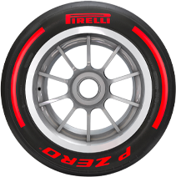
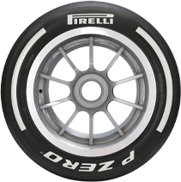







Mixed-Integer Quadratic Problem (MIQP)
$${min \atop {[α}_{1}…α_{N}]} \sum_{i=1}^{N}{\sum_{a=1}^{α_{i}}{t_{tire}(a,c_{i})}}$$
$i$ = stint index
$N$ = number of stints
$c_{i}$ = compounds
$α_{i}$= stint length
Example:
$$i=1$$
$$i=2$$
...
Stint 1
$$c_{1}=S$$
The length of this stint is 2: $α_{1}=2$
Time on $stint_{1}=t_{lap}\left(1\right)+t_{lap}\left(2\right)+…$
Stint 2
$$c_{2}=H$$
The length of this stint is 2: $α_{2}=3$
Time on $stint_{2}=t_{lap}\left(1\right)+t_{lap}\left(2\right)+$ $t_{lap}\left(3\right)$
Time in total = $stint_{1}+stint_{2}+…$

Slide 26




Inserting the $t_{tire}$ formula into the objective function we’re left with equation 3
$$\sum_{i=1}^{N}{\sum_{a=1}^{α_{i}}{t_{tire}(a,c_{i})}}= \sum_{i=1}^{N}{(}k_{0}\left(c_{i}\right)∗ α_{i}+ k_{1}(c_{i})\sum_{a=1}^{α_{i}}{a)}$$
(3)
Recall Gaussian Summation:
$$\sum_{k=1}^{n}{k= \frac{n(n+1)}{2}= \frac{1}{2}n^{2}+ \frac{1}{2}}n$$
If we rewrite $k_{0}\left(c_{i}\right) \text{and}{ k}_{1}\left(c_{i}\right) \text{as} k_{0,i} \text{and} k_{1,i}$respectively, and use the gaussian sum to rewrite the last part of the equation we get to equation 4
$$\sum_{i=1}^{N}{\sum_{a=1}^{α_{i}}{t_{tire}(a,c_{i})}}= \sum_{i=1}^{N}{(}k_{0,i}∗ α_{i}+ k_{1,i}(\frac{1}{2}α_{1}^{2}+ \frac{1}{2}α_{i}))$$
(4)
And finally, in the case that the tires are not new at the start of a stint, a starting age $a_{s,i}$ is introduced. $α_{i}$ is replaced with $α_{i}+ α_{s,i}$ and the offset loss of $a_{s,i}$ is subtracted
$$\sum_{i=1}^{N}{\sum_{a=1}^{α_{i}}{t_{tire}(a,c_{i},a_{s,i})}}= \sum_{i=1}^{N}{(}k_{0,i}\left(α_{i}+a_{s,i}\right)+ k_{1,i}\left(\frac{1}{2}{\left(α_{i}+a_{s,i}\right)}^{2}+ \frac{1}{2}\left(α_{i}+a_{s,i}\right)\right)$$
$−(k_{0,i} ∗ a_{s,i}+ k_{1,i}\left(\frac{1}{2}α_{s,i}^{2}+ \frac{1}{2}α_{s,i}\right)))$
(5)

Slide 27






Expressed in vector notation
$${min \atop {[α}_{1}…α_{N}]} {\vec{α}}^{T}H\vec{α}+f^{T}\vec{α}$$
$$S\text{ubject} \text{to} \sum_{i=1}^{N}{α_{i}= l_{tot}}$$
(6)
$$α_{i} ∈ ℕ^{+}$$
$$∀1 ≤i ≤N$$
$$H= \left[\begin{matrix}0.5k_{1,1} & 0 & ⋯ & 0 \\ 0 & 0.5k_{1,2} & ⋯ & 0 \\ ⋮ & ⋮ & ⋱ & ⋮ \\ 0 & 0 & ⋯ & 0.5k_{1,n}\end{matrix}\right]$$
$$f= \left[\begin{matrix}k_{1,1}\left(0.5+a_{s,1}\right)+k_{0,1} \\ ⋮ \\ k_{1,N}\left(0.5+a_{s,N}\right)+k_{0,N}\end{matrix}\right]$$
(7)
(8)

Slide 28
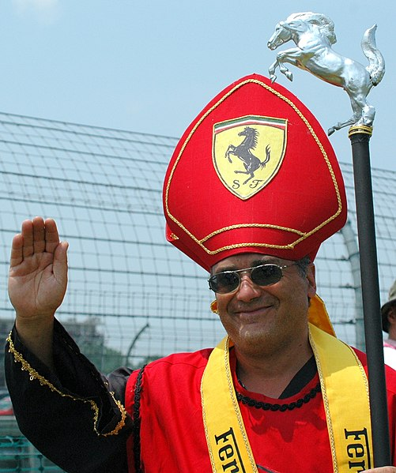
Approach
Finding the optimal racing strategy with the fastest race time using simulation

Slide 29
Strategy Pipeline
Find Tire Combinations
Optimize Stint Lengths
Simulate Race Times
Sort Race Times
Determine Optimal Strategy

Slide 30
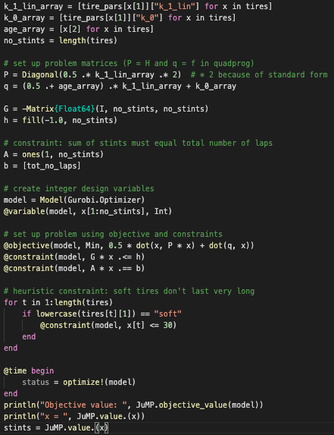
Optimize Stint Lengths
Setup:
Julia/JuMP interface
Gurobi Optimizer
Mixed Integer Quadratic Program (MIQP)
Variables:
N = no. stints
Constants:
Tire k0, k1
Tire age
Number of laps remaining
Soft tire life span
Minimum stint length

Slide 31
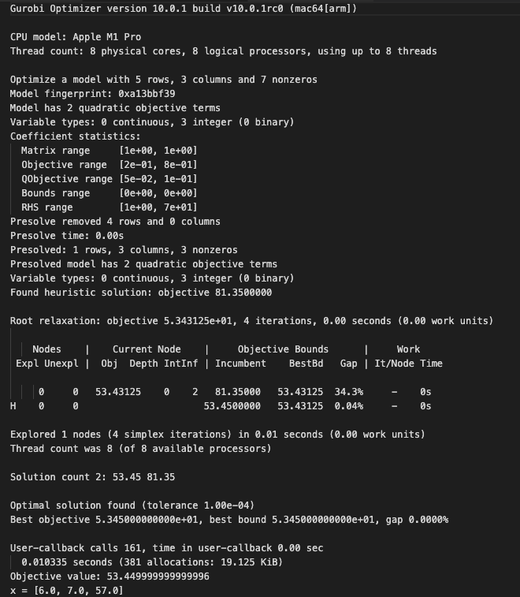
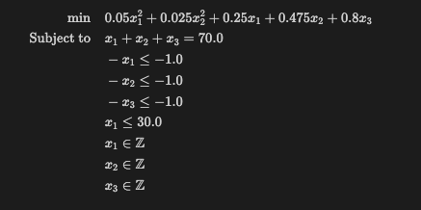
MIQP output
Optimization Model:
x₁ = length of stint of first compound stint
x₂ = length of stint of second compound stint
x₃ = length of stint of third compound stint

Slide 32
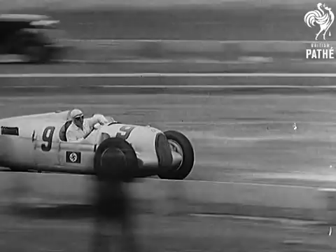


Race Simulation
$$t_{lap}\left(l\right)=t_{base}+t_{tire}+t_{fuel}+t_{pitlap}(l)$$
$$t_{racetime}=\sum_{l=1}^{L_{max}}{t_{lap}\left(l\right)}$$
Input Parameters
Race Strategy
Tire degradation parameters
Base lap time
Total number of laps
Lap time fuel sensitivity
Pit time
Grid position at start
Lap loss time between grid position
Lap loss from standstill
Initial fuel mass
Fuel consumption per lap
The race simulator takes a race strategy:
[(stint 1 start, tire 1 compound, tire 1 age),
(stint 2 start, tire 2 compound, tire 2 age)]
And calculates the race time based on the given strategy
Output
Lap times
Total race time

Slide 33
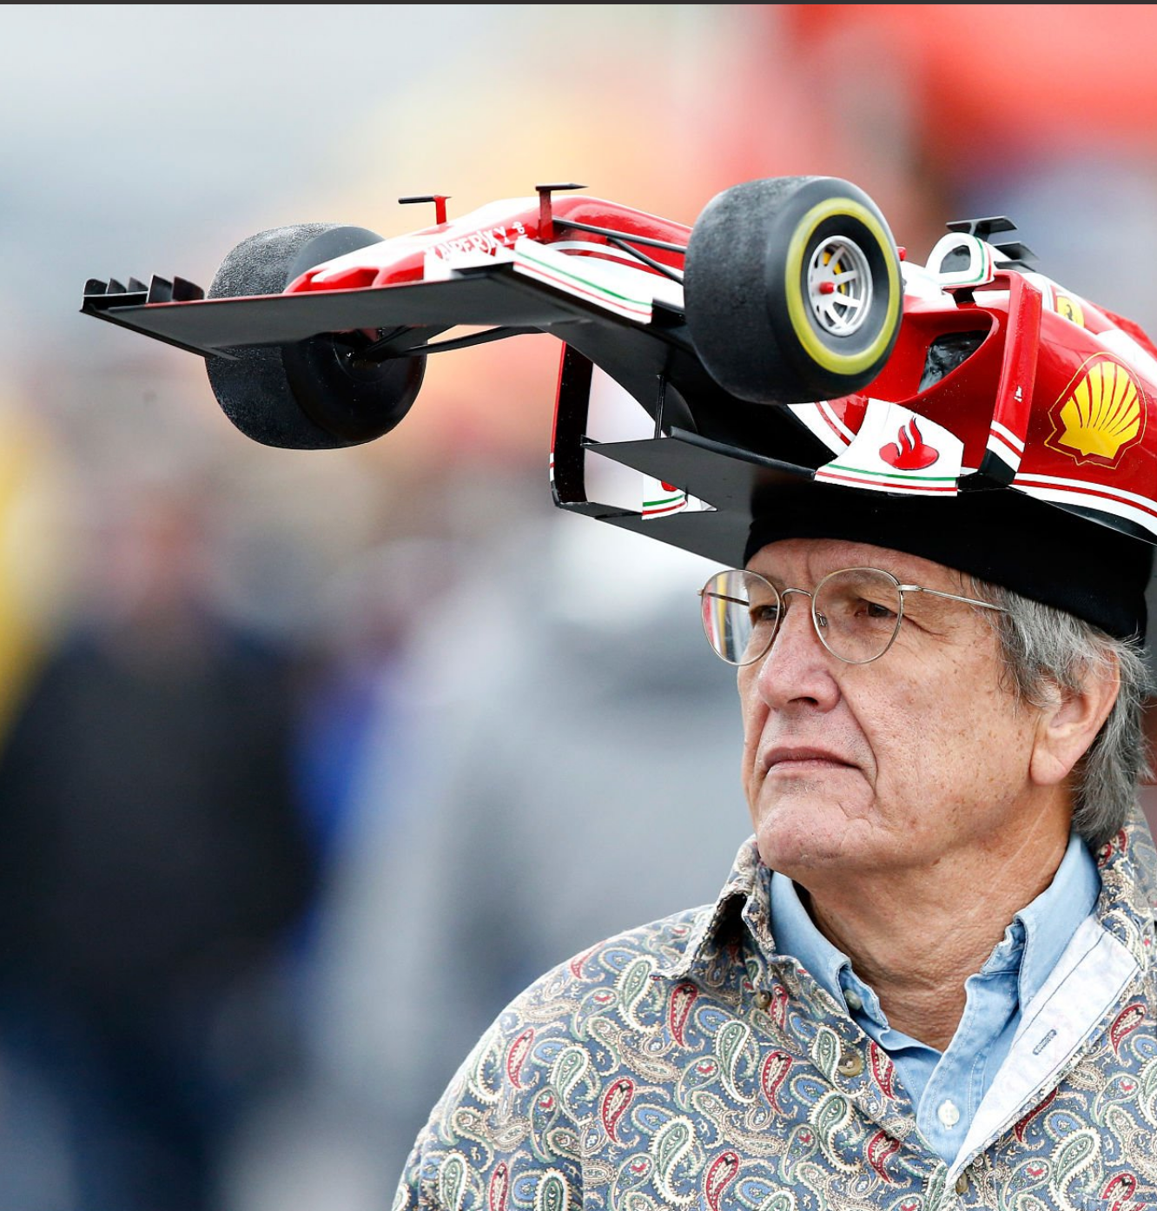
Results
What is the optimal strategy?

Slide 34
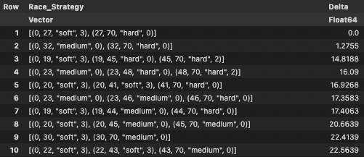
Optimal racing strategy
Pirelli’s Strategy 2
Leclerc’s Plan B
Pirelli’s Strategy 1

Slide 35
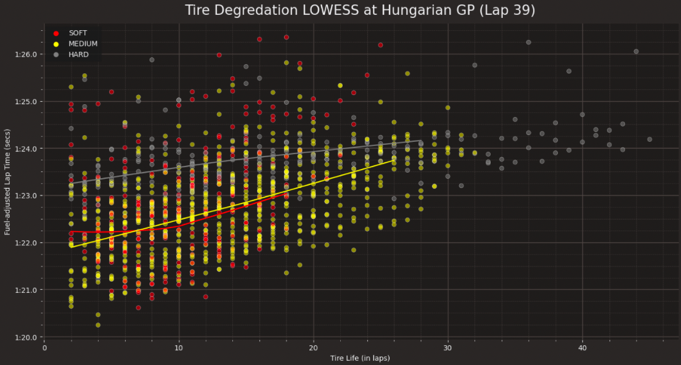
Observed tire degradation by Lap 39

Slide 36
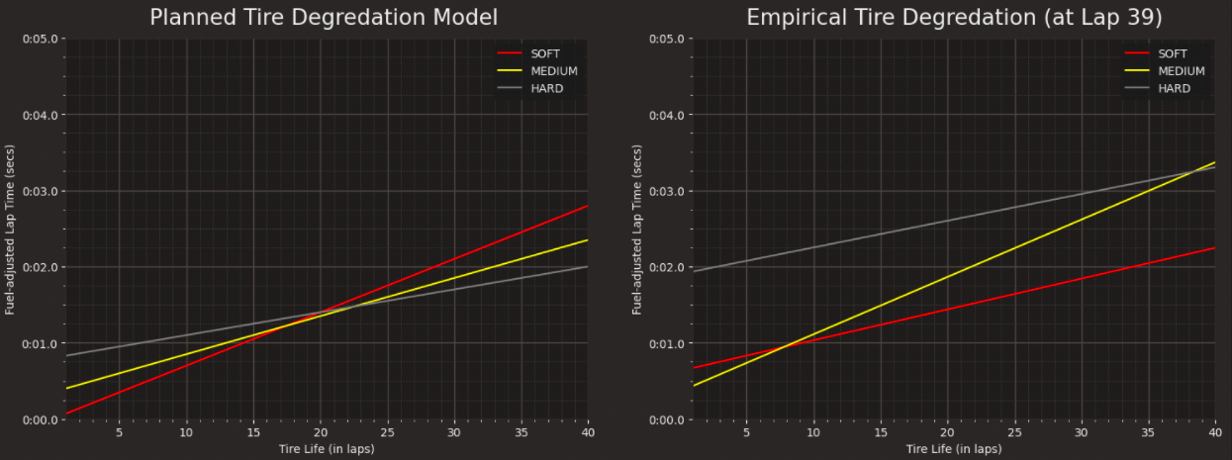
Planned vs. empirical models
Medium-hard crossover
Medium-hard crossover
Soft-medium crossover
Soft-medium crossover
1 second gap in performance

Slide 37
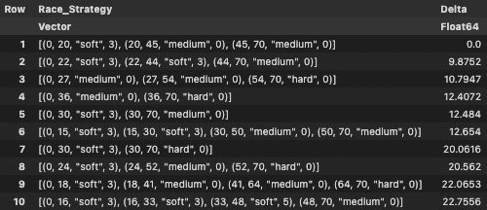
Optimal strategy with empirical model
Pirelli’s Strategy 1
Leclerc’s Plan B
Pirelli’s Strategy 2
Leclerc’s Plan C

Slide 38
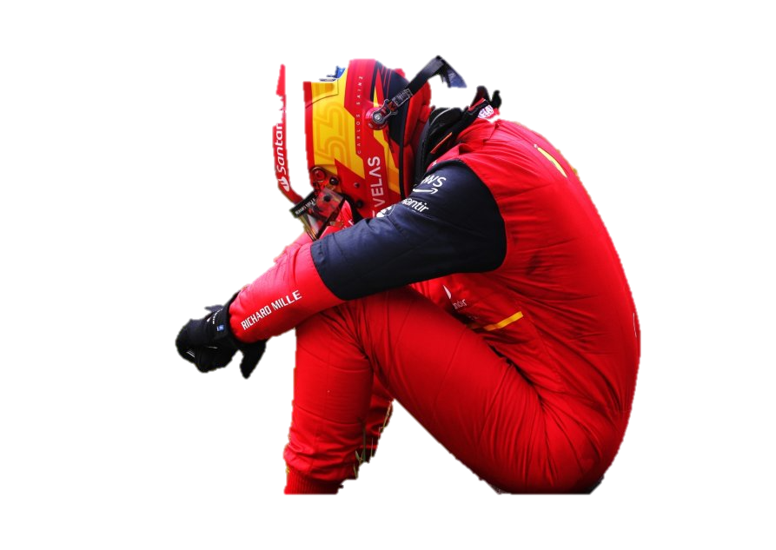
Takeaways
Fastest car isn’t enough to be the fastest
Racing often comes down to tire strategy
Important to keep models up-to-date

Slide 39
Future work
Limitations and improvements for optimization

Slide 40
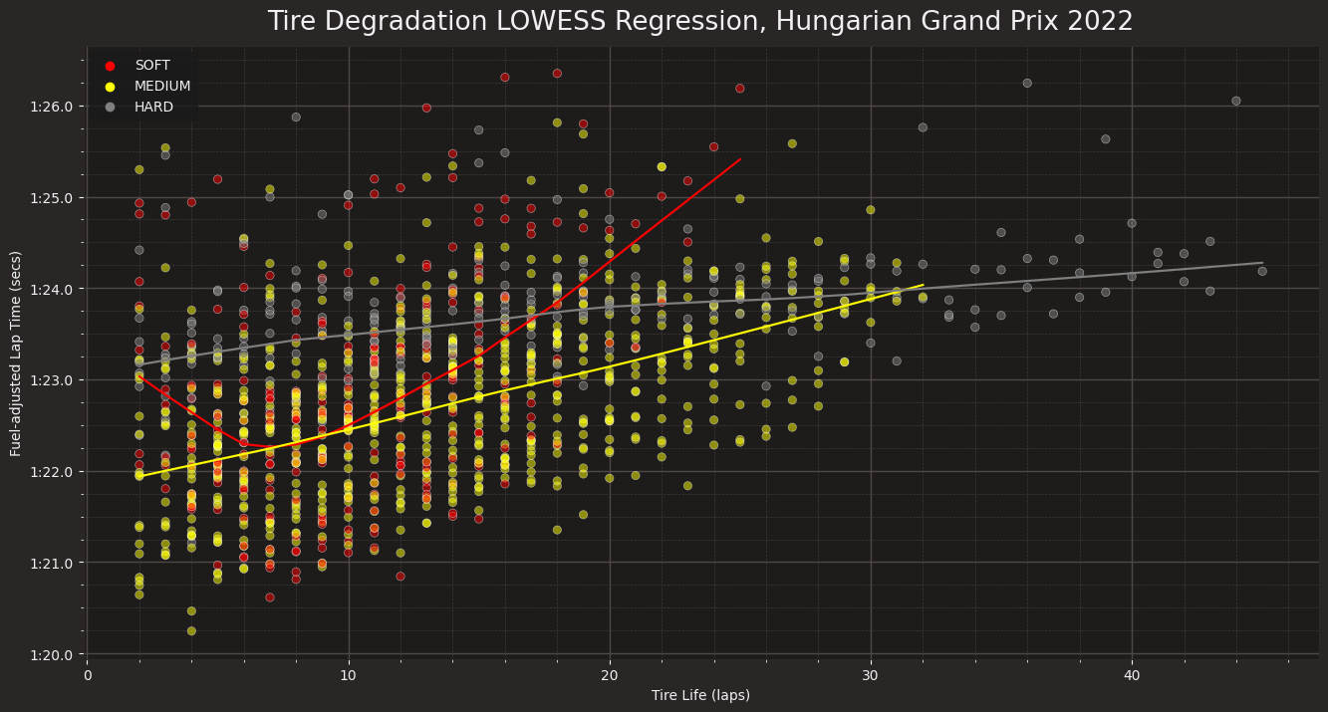
Tire degradation for entire race

Slide 41
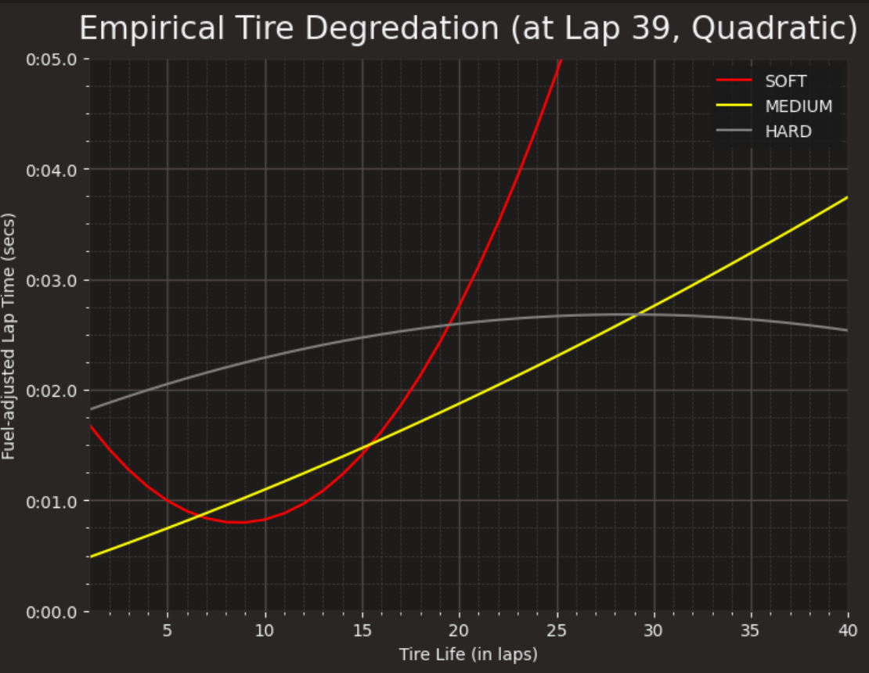
Empirical quadratic model for tire deg

Slide 42
Alternative approaches
Circuit | Overtake and follow delta | Monte Carlo Simulation
Driver | Driver starting grid Driver starting performance (rank changes) | Monte Carlo simulation
Tire | Quadratic tire compound laws | Conic optimization Nonlinear integer prog.
Probabilistic effects | Variability in lap times and pit stop durations Accidents and failure probabilities Safety Car phases | Monte Carlo Simulation Markov Decision Process Neural Networks Reinforcement Learning

Slide 43
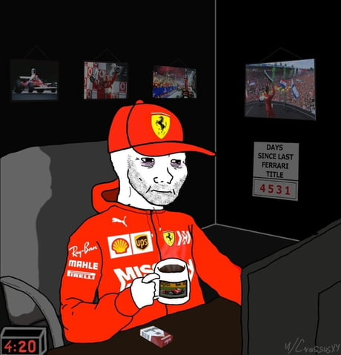
Thank you

Slide 44
References
[1] C. Beaume. Faster than Hamilton! Optimizing Formula 1 strategies. University of Leeds, School of Mathematics, MATH 3001, 2022. http://www.cbeaume.com/download/MATH3001_Formula1.pdf.
[2] A. Heilmeier, M. Graf, J. Betz, and M. Lienkamp. Application of monte carlo methods to consider probabilistic effects in a race simulation for circuit motorsport. Appl. Sci., 10:4229, 2020. https://www.mdpi.com/2076-3417/10/12/4229.
[3] T. Tulabandhula and C. Rudin. Tire changes, fresh air and yellow flags: challenges in predictive analytics for professional racing. Big Data, 2:97–112, 2014. https://www.liebertpub.com/doi/10.1089/big.2014.0018
[4] J. Bekker and W. Lotz. Planning Formula One race strategies using discrete-event simulation. J. Operational Res. Soc., 60:952–961, 2009.
[5] FIA. Event & Timing Information, 2022. https://www.fia.com/events/fia-formula-one-world-championship/season-2022/saudi-arabian-grand-prix/eventtiming
[6] L. Smith. Formula 1 Racing Often Comes Down to the Tires. The New York Times, 2022. https://www.nytimes.com/2022/10/06/sports/autoracing/f1-tires-racing.html.
[7] C. Medland. What are the possible race strategies for the Portguese Grand Prix? F1 Strategy Guide. FIA, 2021. https://www.formula1.com/en/latest/article.strategy-guide-what-are-the-possible-race-strategies-for-the-portuguese.QD1Mt2DmtE3A4las99xyZ.html
[8] TUMFTM race-simulation. A race simulation to determine a race strategy for motorsport circuit races. Race strategy in this context means the determination of pit stops. https://github.com/TUMFTM/race-simulation
[9] Fast F1 Python API. https://github.com/theOehrly/Fast-F1
[10] M. Isola. 2022 Hungarian Grand Prix Preview. Pirelli. Jul. 25, 2022.https://press.pirelli.com/2022-hungarian-grand-prix---preview/
[11] “Ferrari Disaster Class: Is Hard compound ever going to work? A deep-analysis of tire degradation” Tracing Insights. Aug. 4, 2022.. https://tracinginsights.substack.com/p/ferrari-disaster-class-is-hard-compound
[12] Heilmeier A, Thomaser A, Graf M, Betz J. Virtual Strategy Engineer: Using Artificial Neural Networks for Making Race Strategy Decisions in Circuit Motorsport. Applied Sciences. 2020; 10(21):7805. https://doi.org/10.3390/app10217805
[13] Gupta, Ekagra. "The Red Bull & Mercedes Strategy Masterclass: Hungarian GP Data Analysis." MotorSport Magazine, 1 Aug. 2022, www.motorsportmagazine.com/articles/single-seaters/f1/red-bull-and-mercedes-show-the-assertive-strategy-that-wins-titles-hungarian-gp-data-analysis/.

Slide 45
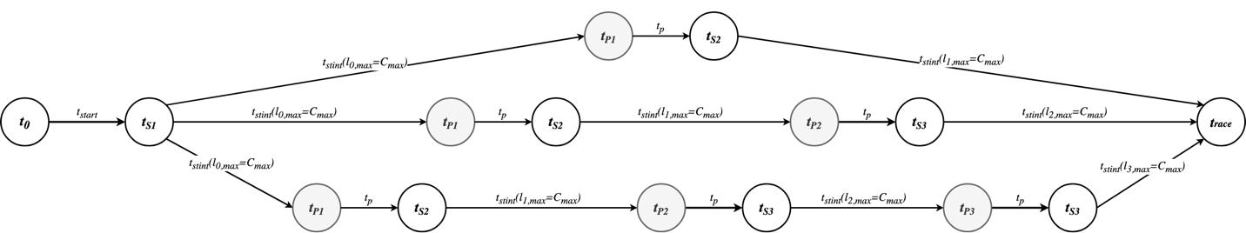
Finding shortest race time

